Slide 1
Pager rotation duties
Trevor mclaurine

Slide 2
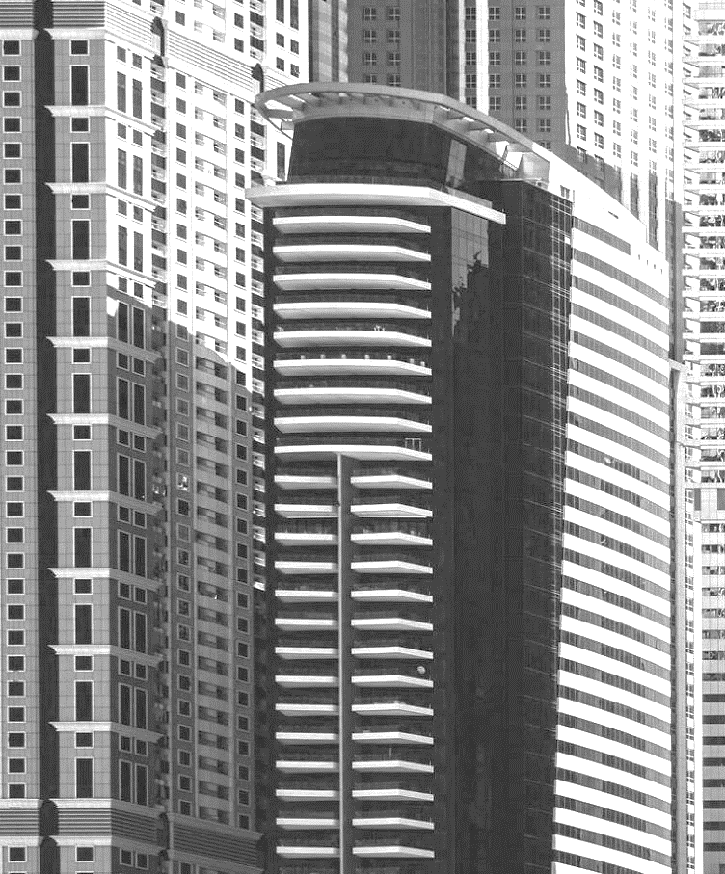
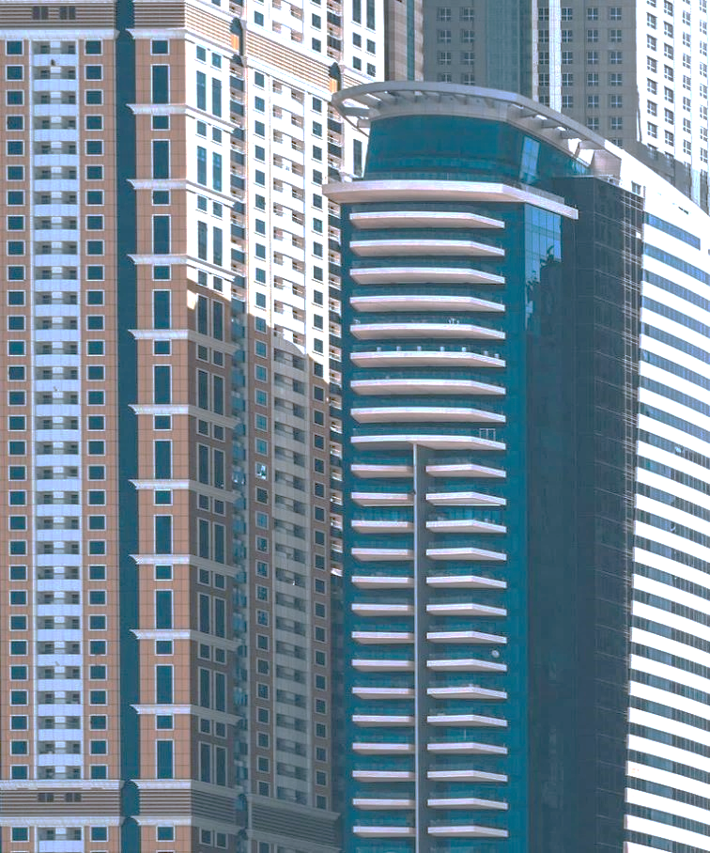
Pager duty
Pager Duty, or pager rotation, is the changing of responsibility of a developer to handle various issues when they arise. It could be thought of as changing of a guard at a security desk. One guard goes off shift while the other guard assumes the role of the previous guard when handling various issues.

Slide 3

Why pager duy?
Even when an app is shipped correctly and there are no issues at launch, other issues may still arise that were previously unforeseen.
As these defects pop up and continue to build, production can fall behind which results in less features being delivered and more backlogged work.
Pages Duty helps solve this by divvying up the work to those in the value stream as well as individuals whose sole job is to fix errors.

Slide 4
Effects of pager duty
Pager duty helps show that business goals are accomplished by simply marking 'done' on a project. Instead, through testing and surveillance, we need to ensure that our application is running perfectly in a production environment. Assigning pager duty helps show the developers building these features the steps it takes to get an application to actually work in production.

Slide 5

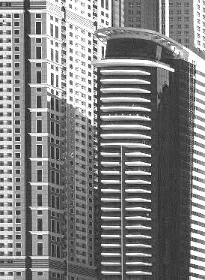

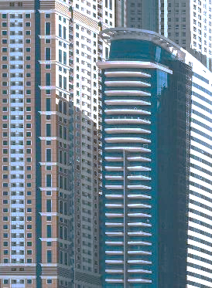
Everyone fixes everything
Another side effect of Pager Duty is that everyone who touches code is responsible, in some way, for fixing the code when things go haywire. This way, the sole burden of fixing the application doesn't just fall on the operations team. Now, developers must figure out how to fix the problem in their own way.

Slide 6
Independence
Developers and development companies who take part in this practice gain a certain form of independence. No longer do developers need to wait for Operations to fix the problem. Instead, they fix it themselves. In some ways, this dissolves the hierarchy of developers. No longer is a developer just a developer for a certain part of the project. Everyone does everything and everyone can do everything. This creates independence with the developers as they rely much less on other people to fix their own problems.

Slide 7
Culture Change
By removing the hierarchy between developers and giving everyone the responsibility to fix their own problems, the culture of the team will change. Instead of just focusing on their issues, now the team comes together to remove these roadblocks. This unifies developers and helps ensure that the application is running the way it's supposed to be.

Slide 8
Closer to the customer
As developers, it's easy to only look at the product we're creating as nothing more than code. With Pager Duty, however, developers are now able to see and interact with the complaints of customers. These complaints help developers show that there are actual people using these applications. When developers understand that this is affecting a real human being, we become closer to that person and fixing the issue at hand becomes that much more important.

Slide 9
Certain downsides of pager duty
Like anything, there is certain give and take with how we handle debugging our applications. While Pager Duty creates a great sense of teamwork within developers and helps solve issues quickly, it does slow down other features that could possibly be worked on. Also, any legacy code that people might not be familiar with will take time to understand and can slow down the process even further.

Slide 10

SUMMARY
Despite the possible downsides, pager duty is a great way for developers in the value stream to address many of the issues that comes with launching an application. Pager Duty shows developers real customer complaints that they themselves become responsible for fixing. This teamwork helps reduce the number of bugs needing to be fixed and ensures that everyone is part of the debugging process.

